Slide 1

CT0540 - Social Network Analysis
An Insight into Twitter Networks of Central Banks
28th February 2023
André Ramolivaz
Notes:
Push the boundaries of technological and analytical possibilities to reduce operational IT risk
Improve my technical skills

Slide 2
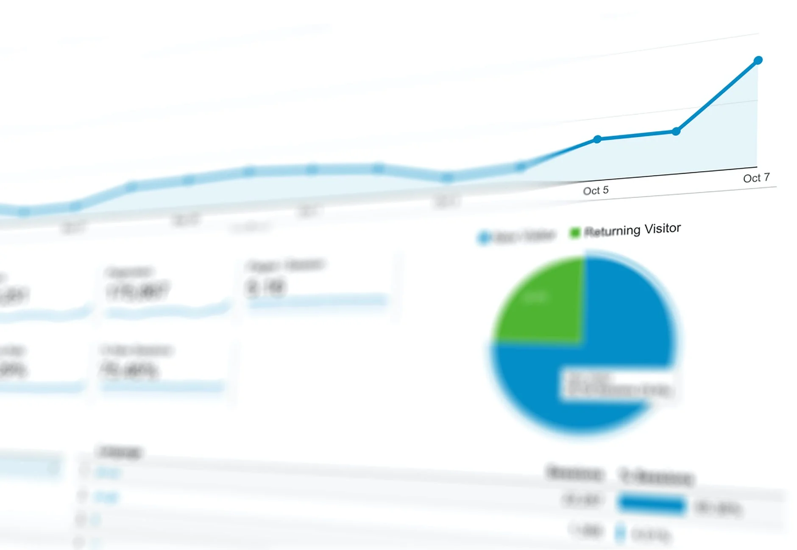





Overview
Aim and objectives
Methodology
Examine the neutrality of central banks during the social media era.
Analyze the twitter network (using as a case ECB, FED and BoE)
Evaluate the sentiment of tweets and most discussed topics
[Tentative] Find correlation between stock market and sentiment on Twitter.
Comprehension of the main goals of the project, identifying the variables needed, research of the technology available
Data collection
Data exploration
Understand variables used, treating missing values, transforming data into a suitable form for analysis, identifying relevant correlations among values
Analysis and targeted Adjustments
Sentiment Analysis, Topic Modeling, Hashtag Interpretation, removing stop words, lemmatization, lowercasing the tweet text …
Deployment of the Gephi Network Graph
Classify users and nodes, export data into csv and uploaded for Gephi, applied layout for colour and visualization
Analysis of a case study
Sentiment Analysis, correlation with the stock market, personal interpretation of the results
Software development
Study/ training
Data Analysis
2
2

Slide 3


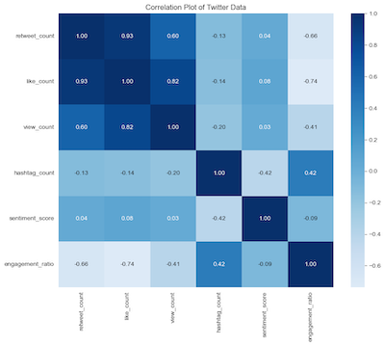
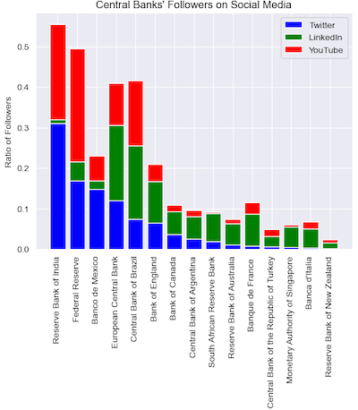
Data Collection and Data Exploration
Tweets
Followers
Snscrape python library
Official Twitter API
3

Slide 4

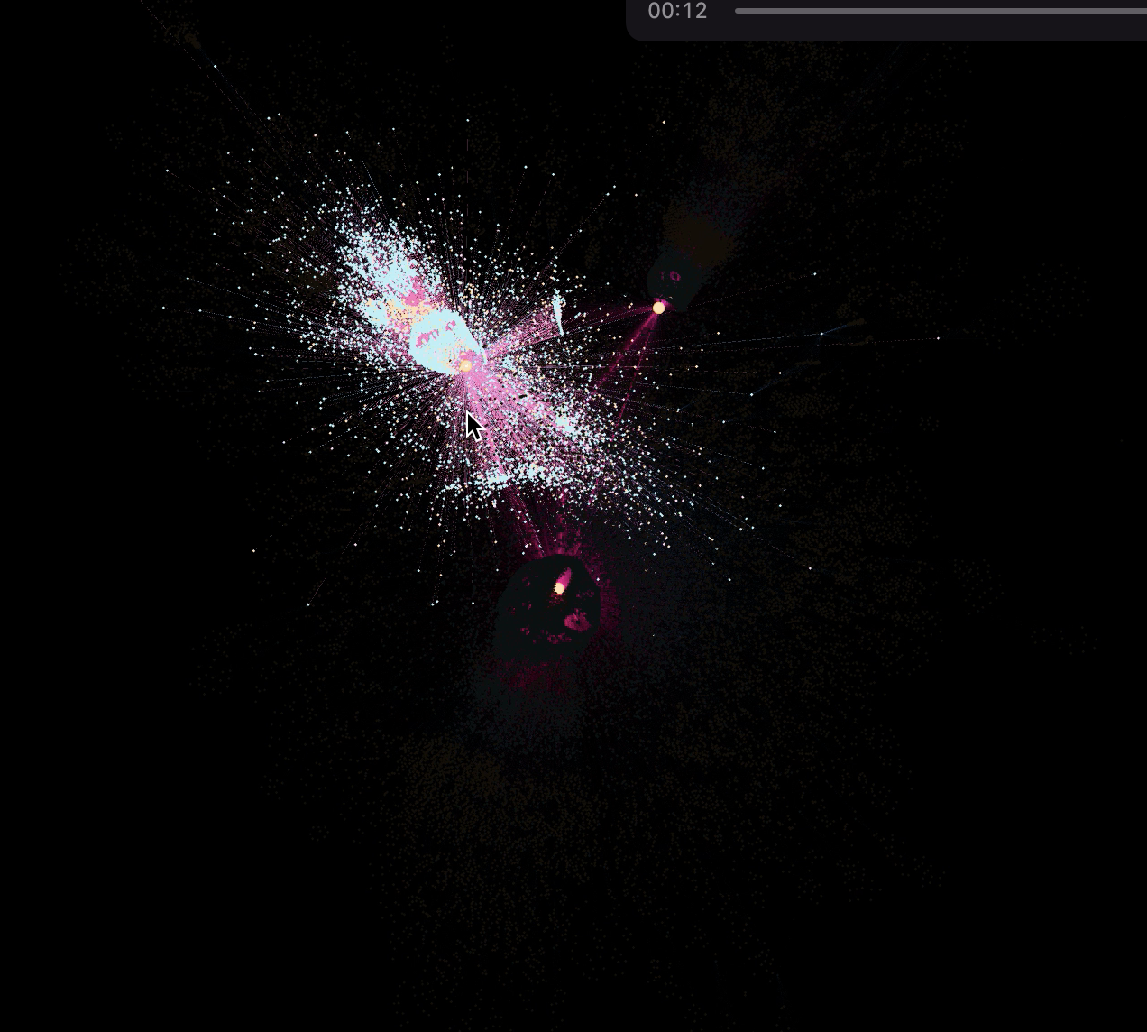
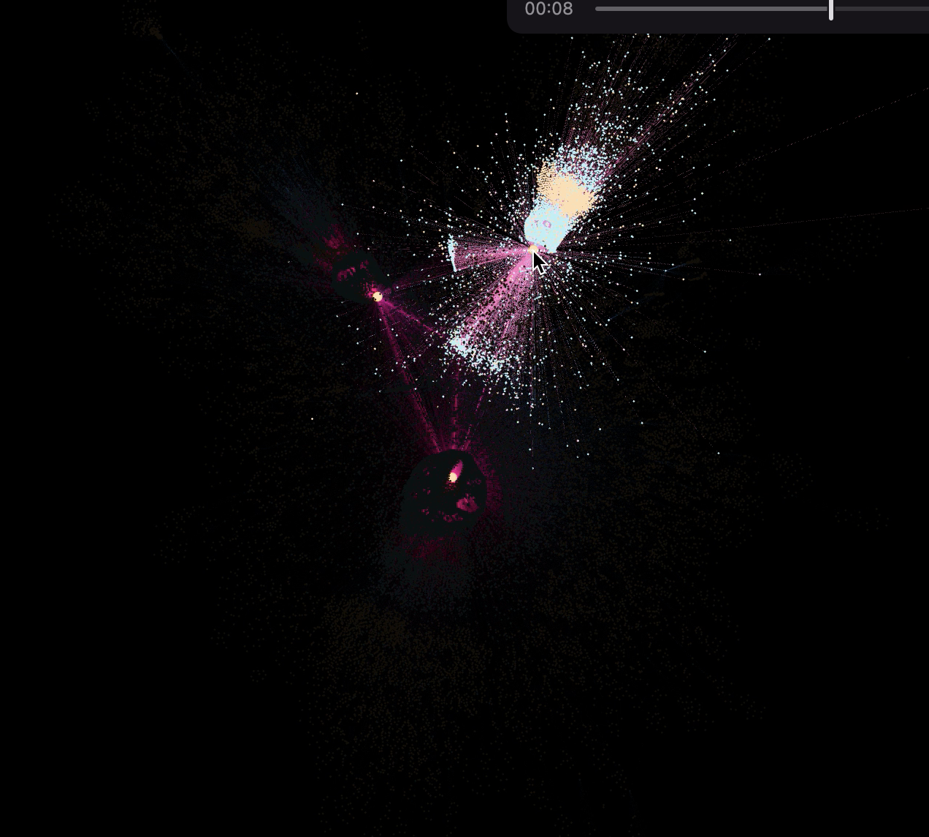
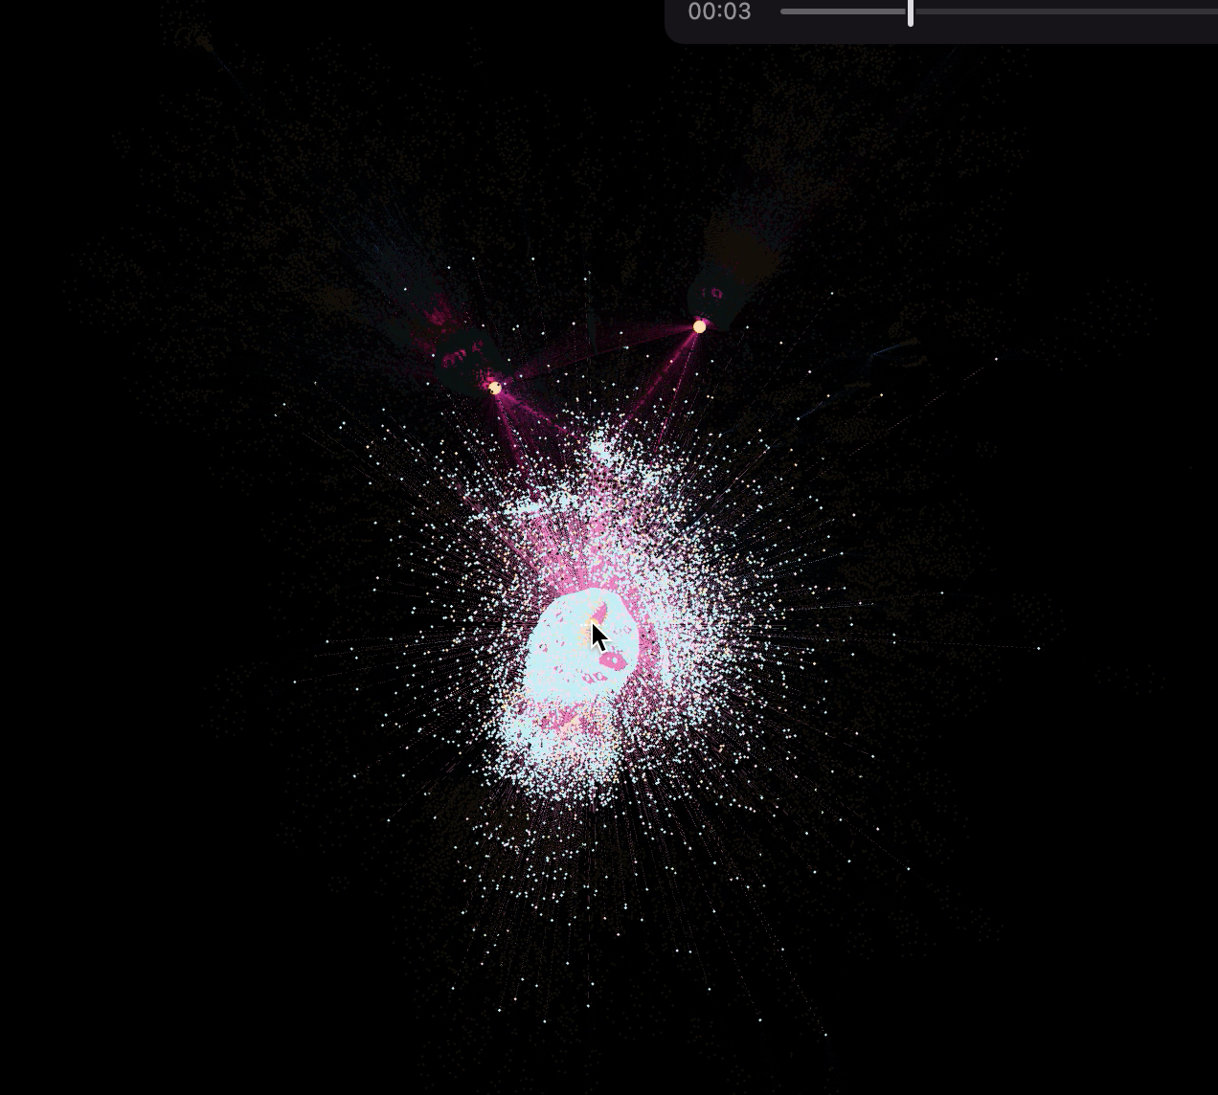
Fig. 1 BCE
Fig. 2 BoE
Edges: 91519
Tweet
Mention
Follow
Fig. 3 FED
Nodes: 63590
Politic
Unknokwn
Inestimable
Finance expert
Analyst
Supporter
Curious
Critic
Contpirator
Gephi Network Graph
4
4

Slide 5

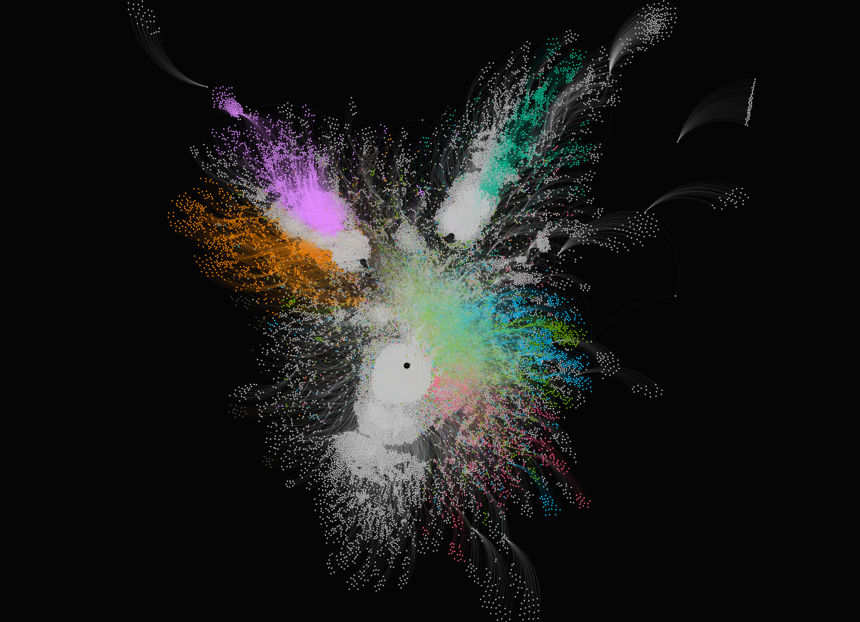

With hubs:
Modularity: 0,515
Number of Communities: 293 Average Degree: 2,878
No hubs:
Modularity: 0,826
Number of Communities: 36875 Average Degree: 1,191
Modularity community detection
5
5

Slide 6
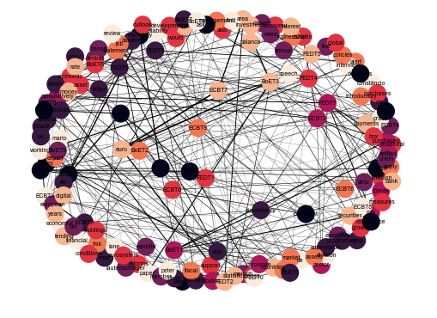
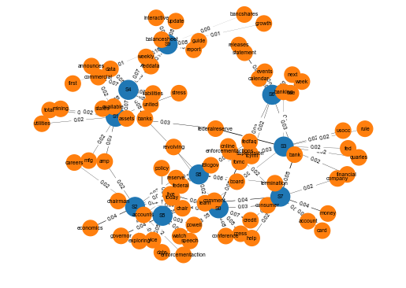
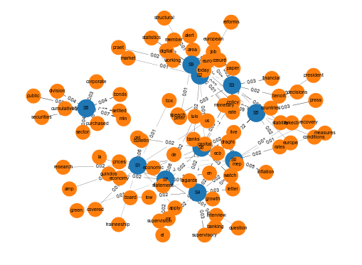
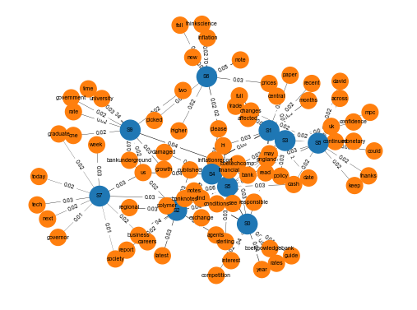
Topic Modeling
Nodes | 148
Edges | 300
Density | 0.02758
isConnected | true
Avg. Shortest path | 3.9261
Fig. 4 Connection of topics among the three banks
Fig. 1 Federal Reserve’s Topic Modeling Network Graph
Fig.3 European Central Bank’s Topic Modeling Network Graph
Fig. 2 Bank of England’s Topic Modeling Network Graph
6

Slide 7
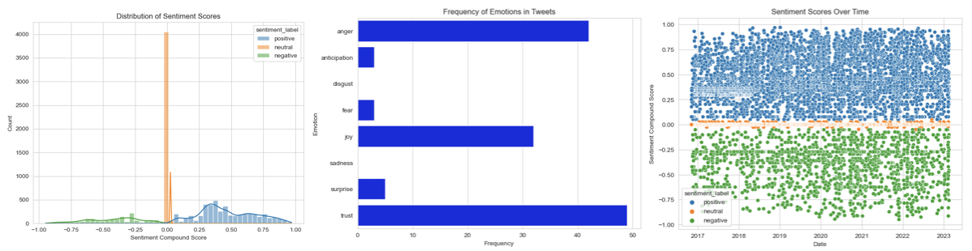
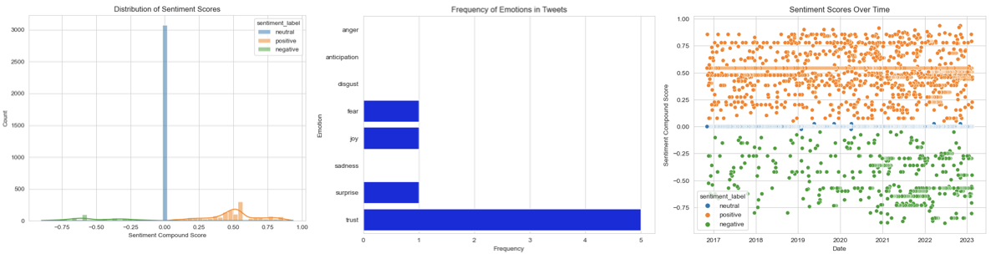
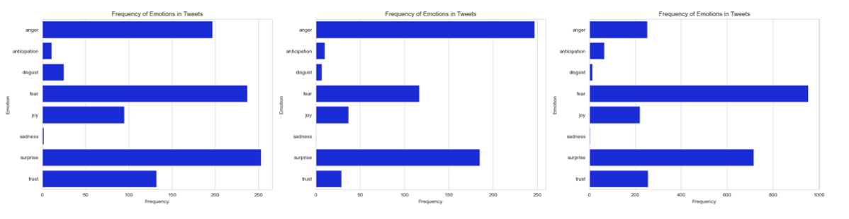
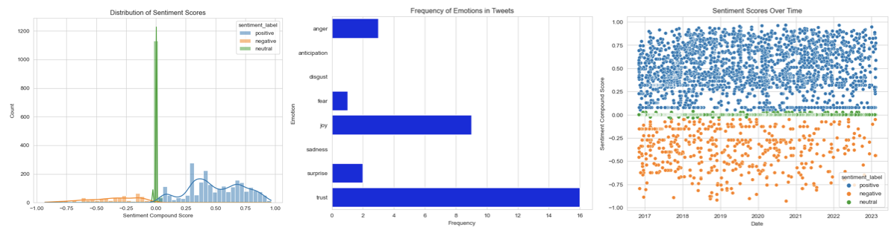
Sentiment Analysis
Fig. 1 European Central Bank’s tweet Sentimet Analysis
Fig. 2 Federal Reserve’s tweet Sentimet Analysis
Fig. 4 Sentiment Analysis among all users
Fig. 3 Bank of England’s tweet Sentimet Analysis
7

Slide 8

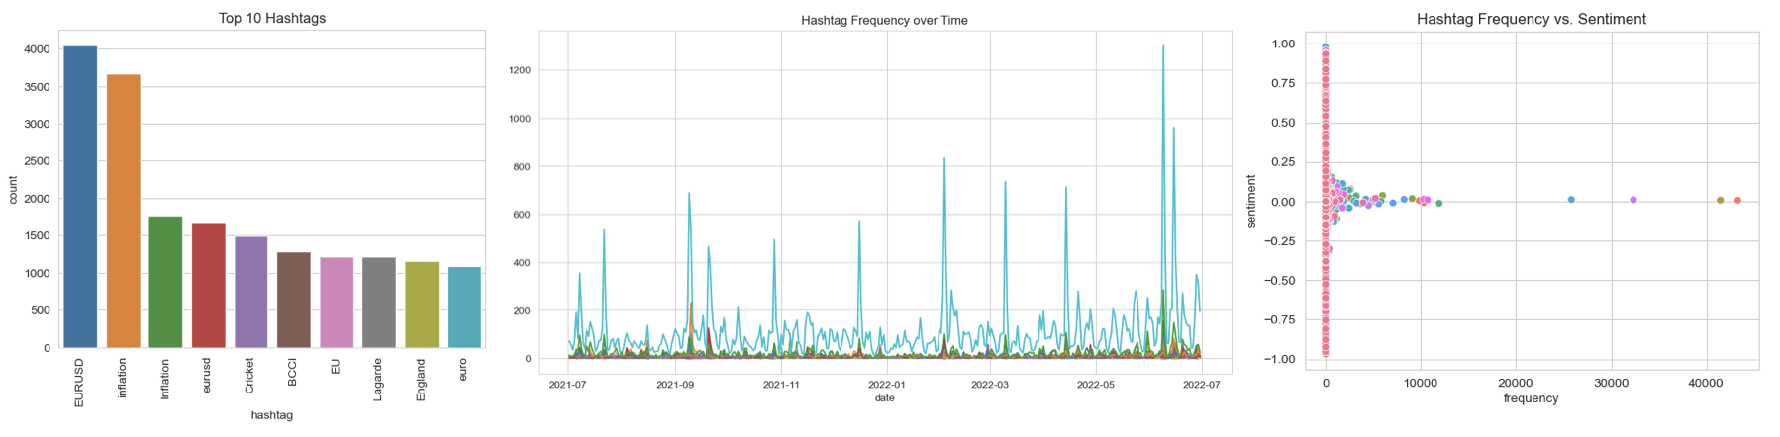

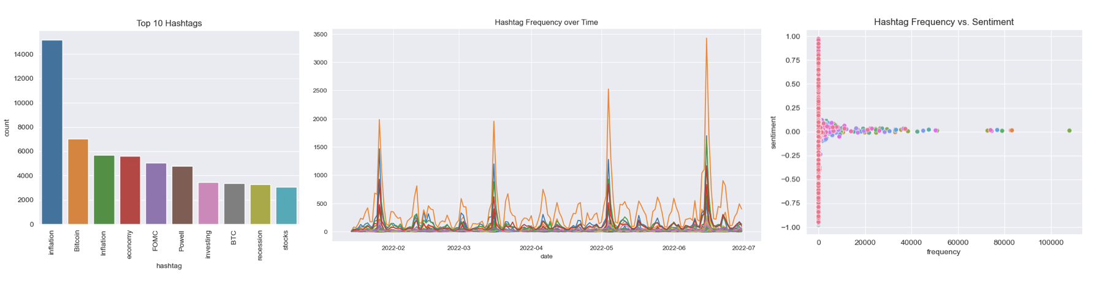

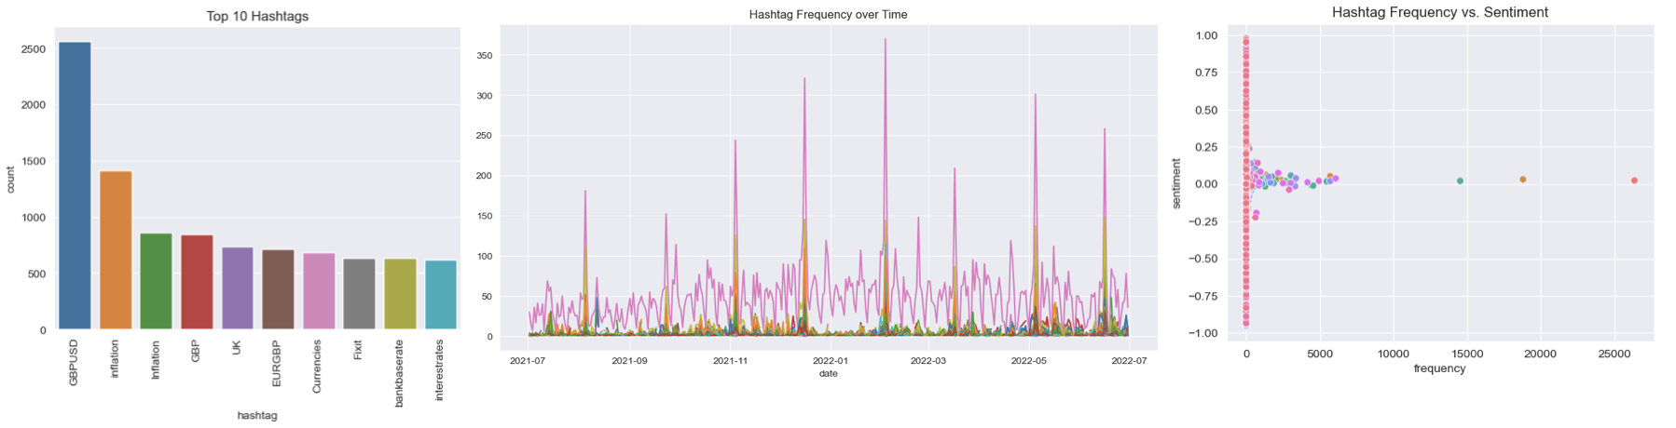

Hashtags Analysis
ECB
Fig. 1 ECB Hashtag (top 10, frequency and sentiment)
FED
Fig. 2 FED Hashtag (top 10, frequency and sentiment)
BoE
Fig. 3 BoE Hashtag (top 10, frequency and sentiment)
8

Slide 9


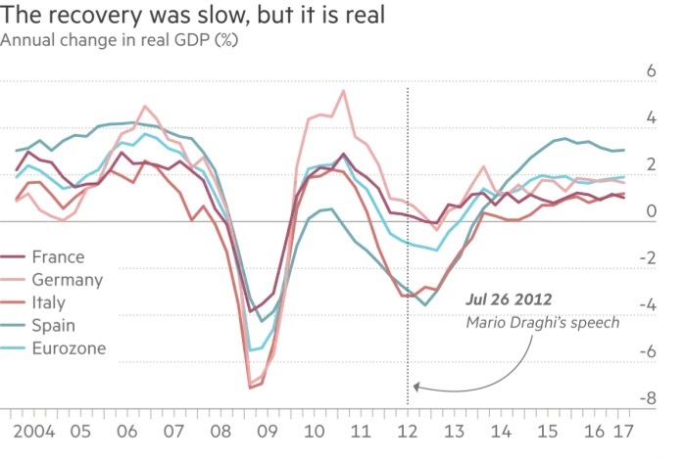
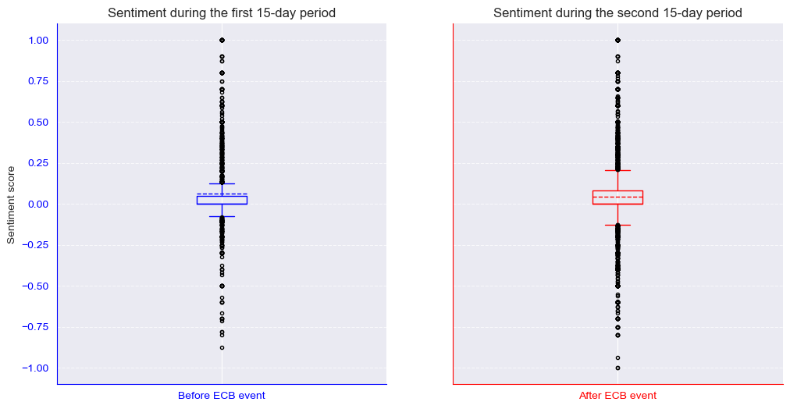
A Case Study the: “ whatever it takes”
Sentiment Analysis
Stock Market
9

Slide 10
Thank you
for your attention!

